Slide 1
Enterprise Java Bean
State full Session
EEnterprise Architecture
Hndit 2 year 2 semester
sliate

Slide 2
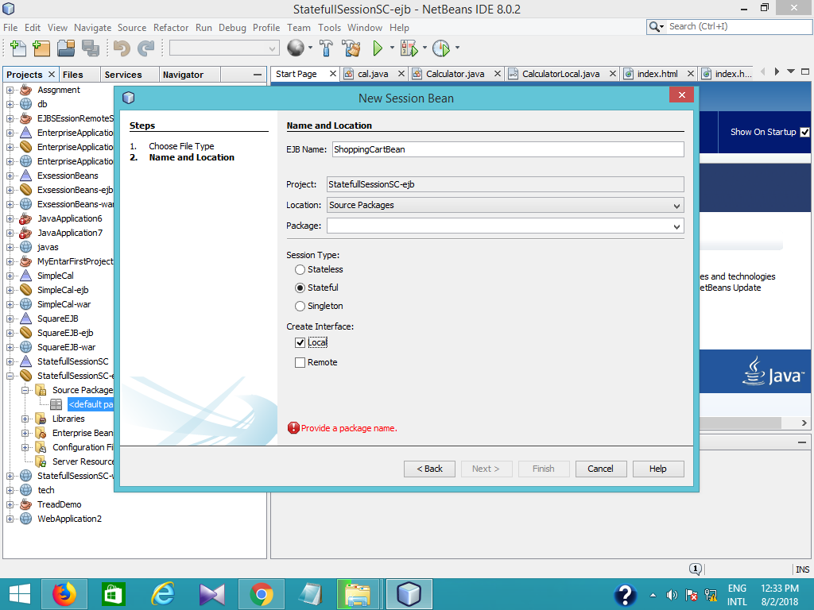

Slide 3
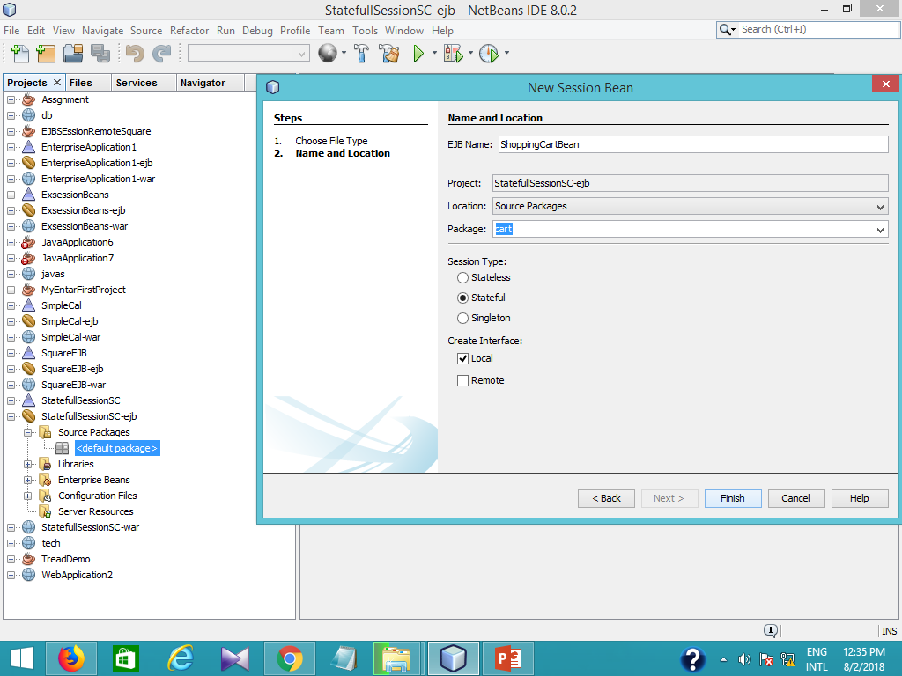

Slide 4
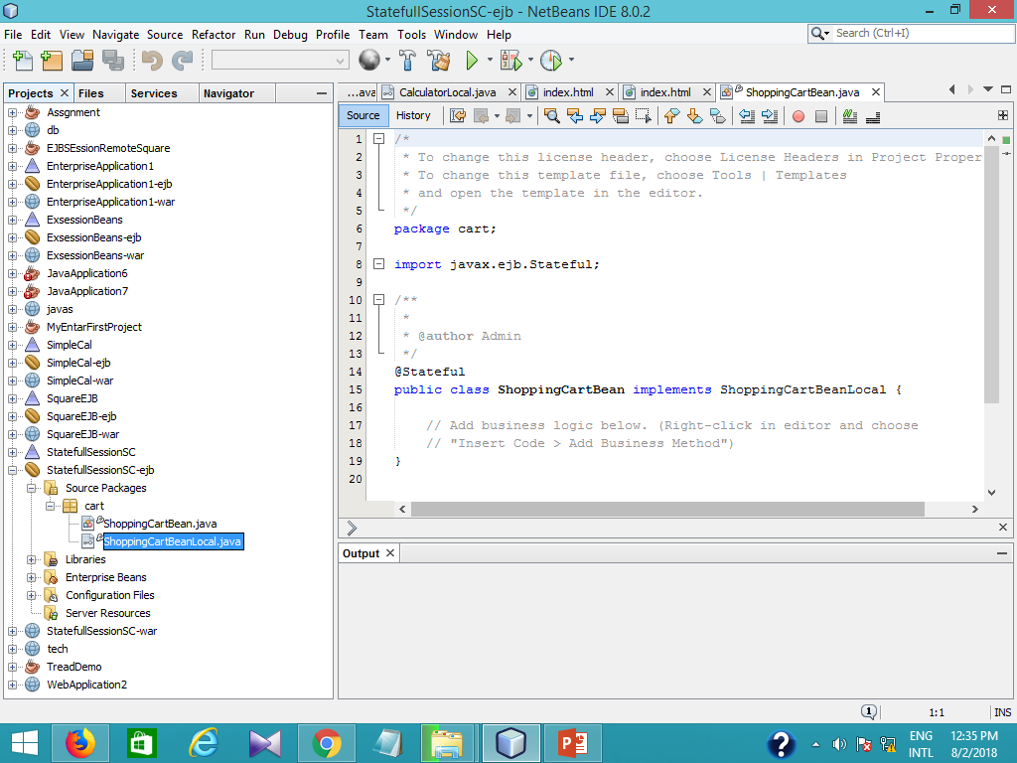

Slide 5
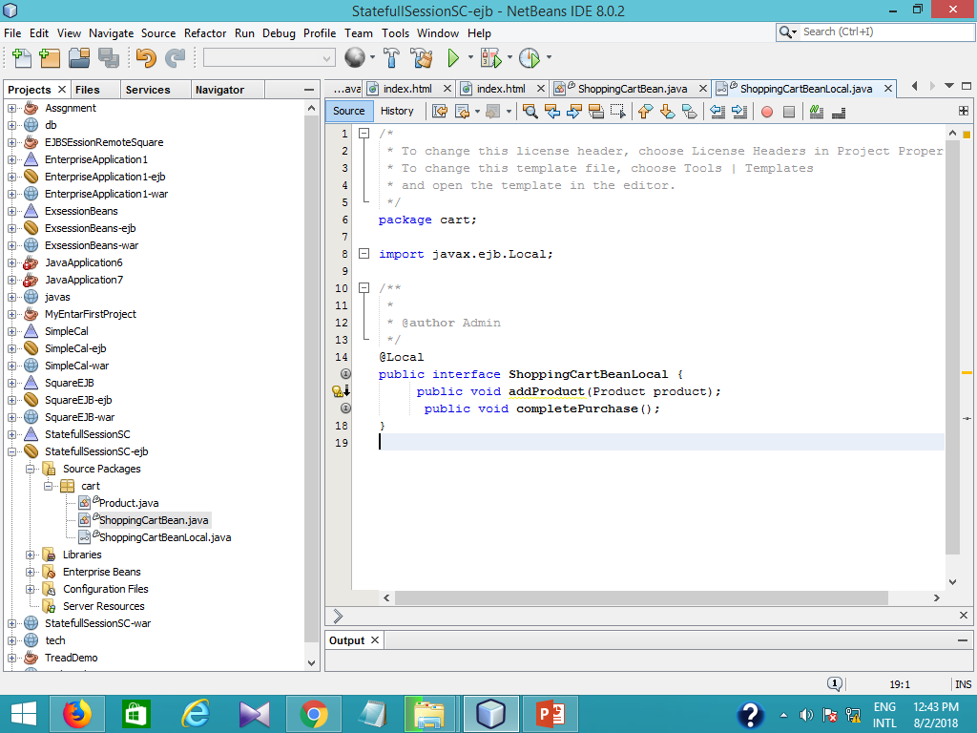
Include method signatures in local interface - @Override
public void addProduct(Product product){
products.add(product);
}
@Override
@TransactionAttribute(TransactionAttributeType.REQUIRED)
public void completePurchase(){
for(Product product : products){
em.persist(product);

Slide 6
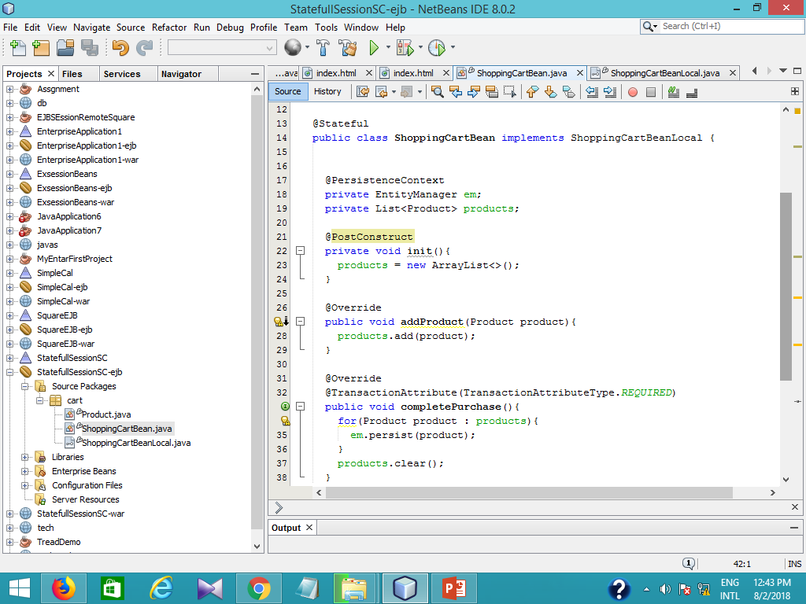

Slide 8
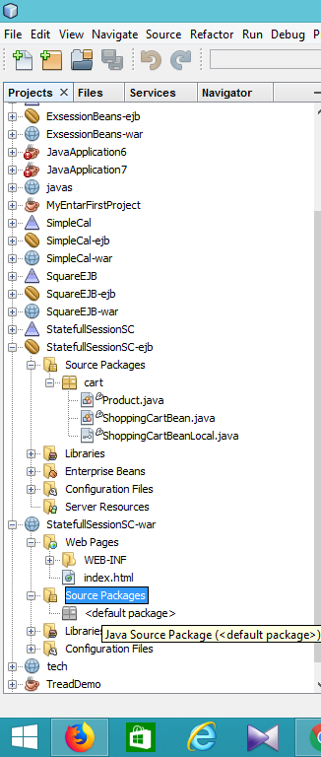
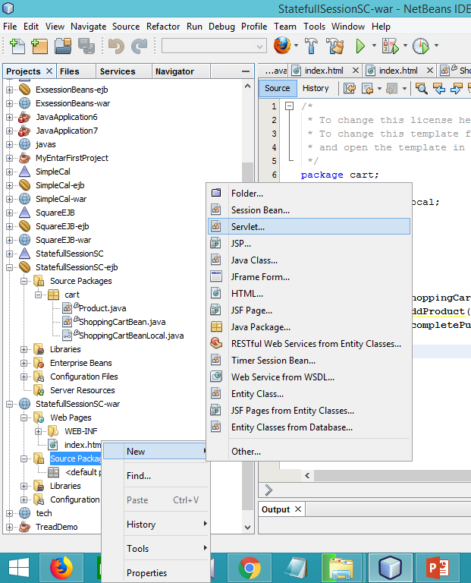
Create servelet

Slide 9
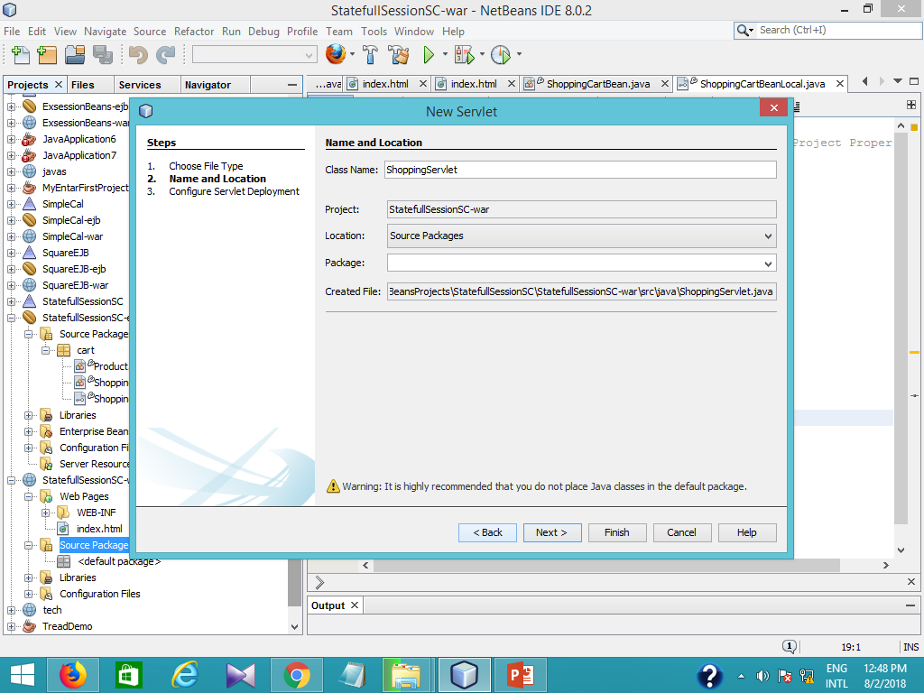

Slide 10
